Slide 1
MyLegion.org
Administrative Tasks
Reports – Labels – Letters
The American Legion
Sons of The American Legion
July 2023
Notes:
MyLegion is The American Legion’s membership website. Through MyLegion, members of The American Legion and Sons of the American Legion can view and manage their membership on file at National Headquarters. Adjutants and commanders, through their individual accounts, will have a My Groups area to assist with post and squadron administrative tasks.

Slide 2
Reports, Labels & Letters
Consolidated Reports – CPR and CSR
Post/Squadron Current Roster
Member Online Renewals
Roster Updates
Member Dues History
Paid Members by Post / Squadron
3x10 Labels
Renewal Letter and Labels (New June 2023)
Find Members in My Area - HQ Mbr Listing (TAL)
Project Stay Active (TAL)
Notes:
Reports play a vital role when tracking membership. MyLegion offers a variety of reports, labels and letters.

Slide 3
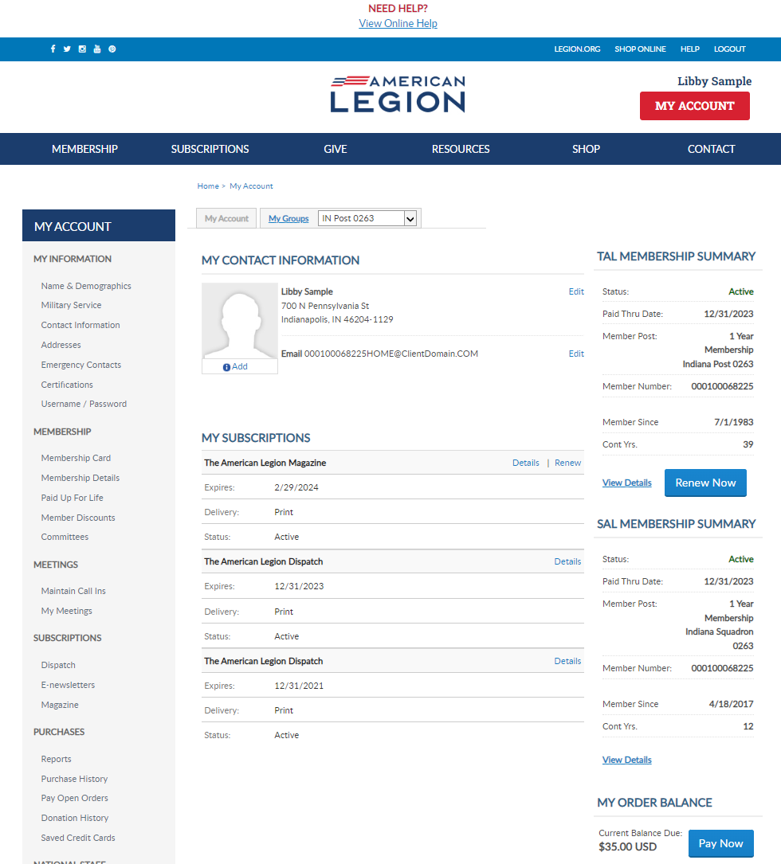
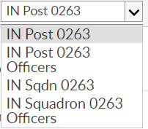
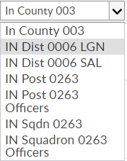
primaryemail@outlook.com
000123456789
2024 renewals available July 1, 2023
000123456789
Notes:
Log into MyLegion and proceed to the My Groups menu.
Post Adjutants and Commanders will have 4 groups. One for the post, post officers, squadron and squadron officers. <1>
Squadrons only have squadron groups <2> Counties and districts will also display if applicable.
To mange your group click on the group in the menu. Let’s go to a post. <3>

Slide 4
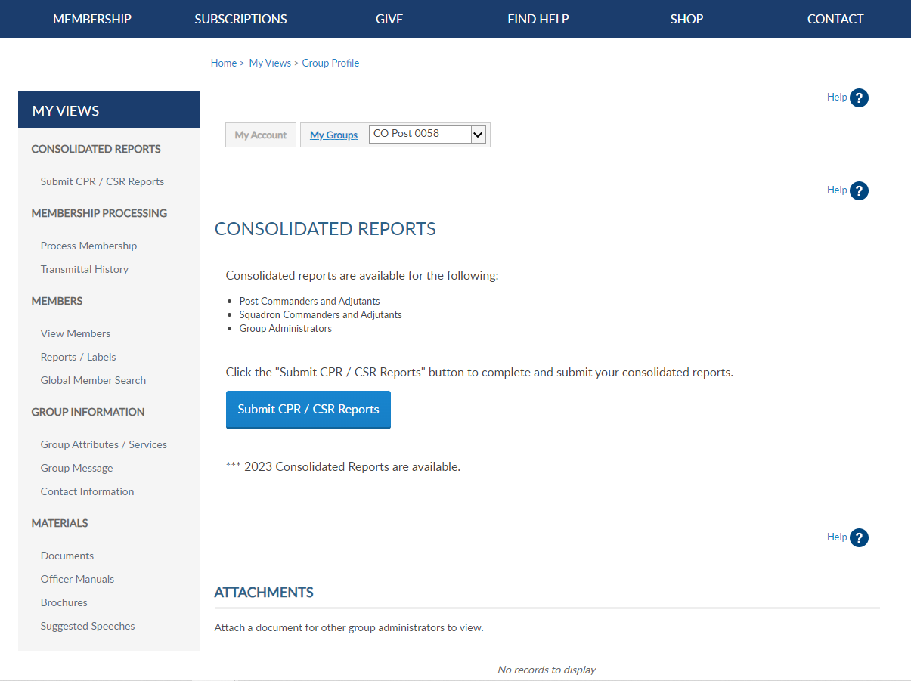
Notes:
Consolidated reports are located on the left menu.

Slide 5
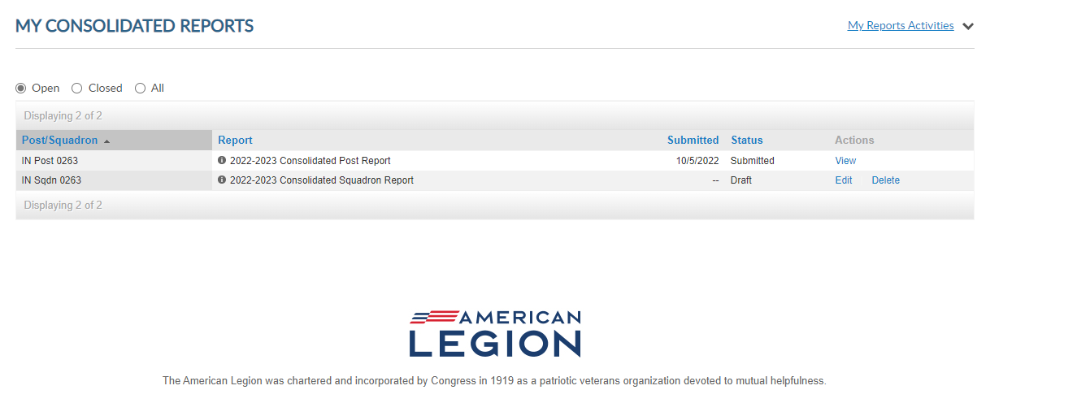
Consolidated Report
Reports submitted online do not need to send a paper report.
Notes:
There are 3 view areas in consolidated reports. Open includes the current report available to enter data.
There is only one open report for the reporting year. When available, you can edit the report until it is finalized or the final submission date. Once, finalized the report is moved to Submitted and the edit link is no longer available.
To enter information in the report, click Edit. <1> If you submit online, you do not need to mail a paper form. The department has access to submitted report data.

Slide 6
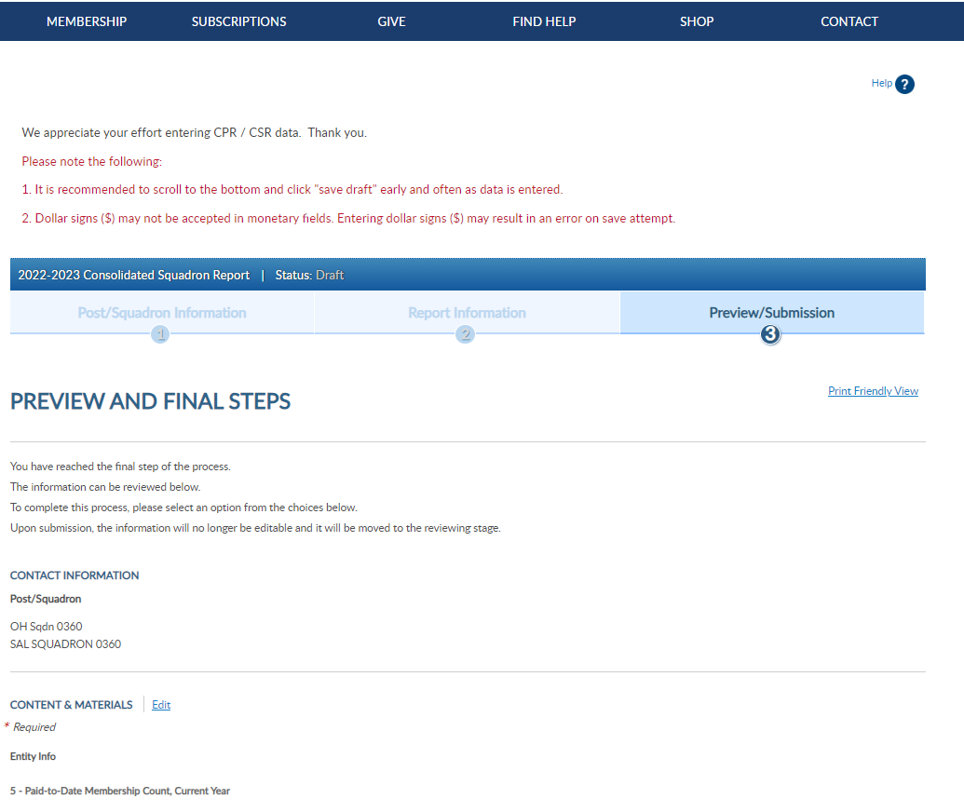
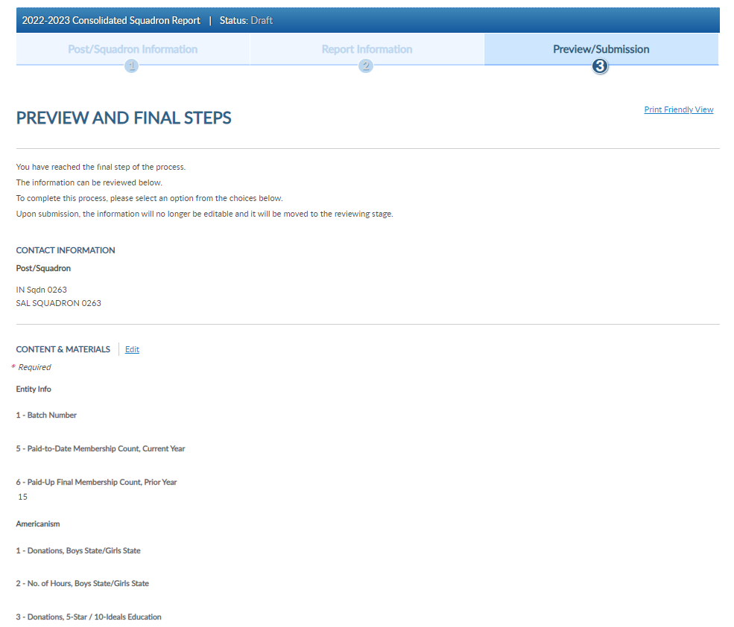
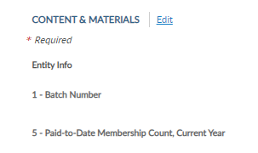
Consolidated Report
Notes:
Click edit to open the fillable form.

Slide 7
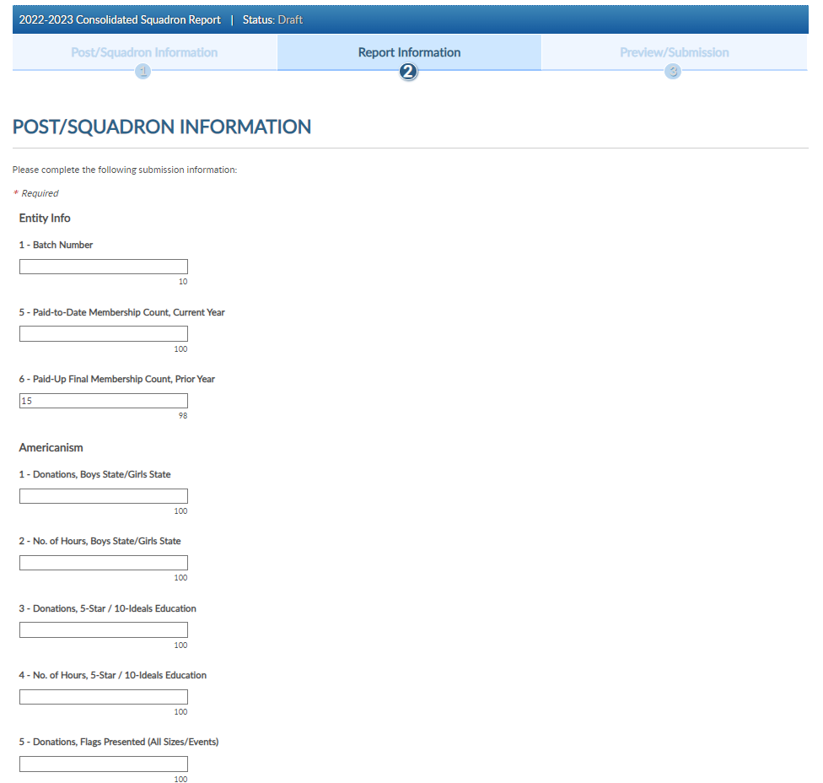
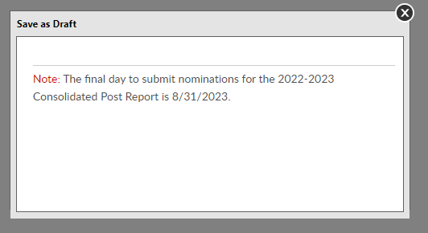
Notes:
When your entries are complete save the draft or finalize the report. These buttons are located at the bottom of the form. <1>
To save and return to the form later, choose Save as Draft. <2> the draft must be finalized by August 31, 2023.

Slide 8
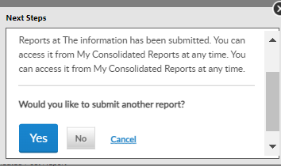
Notes:
To finalize the report, click Next. <1> and Submit Final. You will receive a notification the report is submitted.
Note, once the report is finalized it is saved as a submitted report. You will not be able to add data once submitted. If you plan to make additional updates, click Save as Draft and finalize by the due date.
This report does not need to be mailed if completed online.

Slide 9
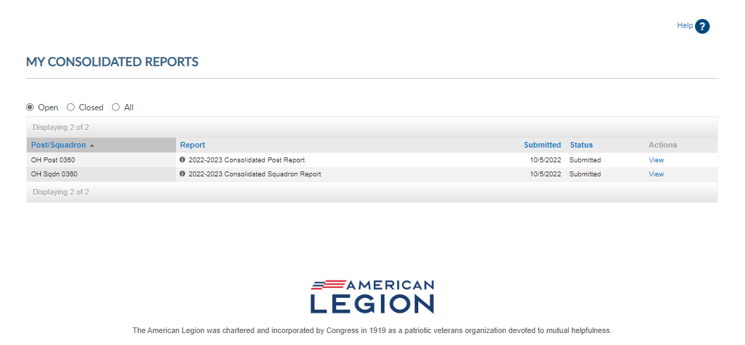
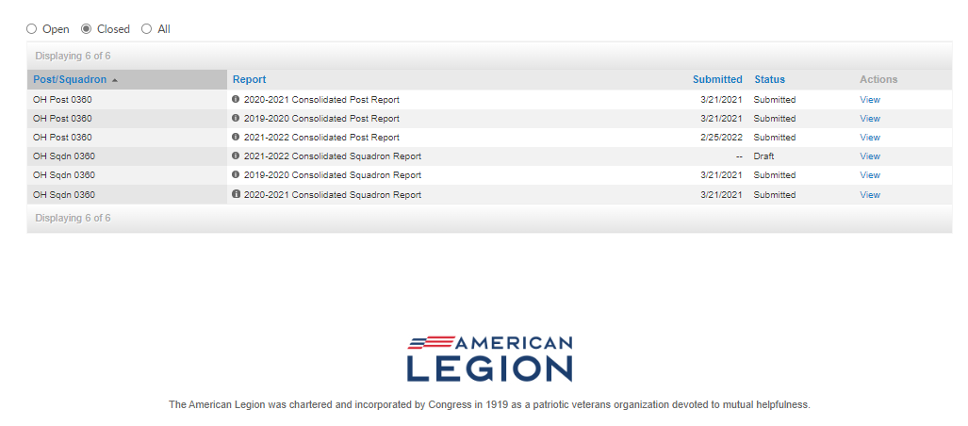
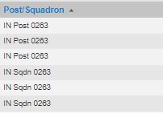
Consolidated Reports
Notes:
Submitted reports will remain in the Open area with a submitted status until the report is closed for the year. To view, or print, click View. <1>
<2> Current and previous reports are also available in Closed. Reports from the 2020-2021 reporting years are available and can also be viewed and printed..

Slide 10
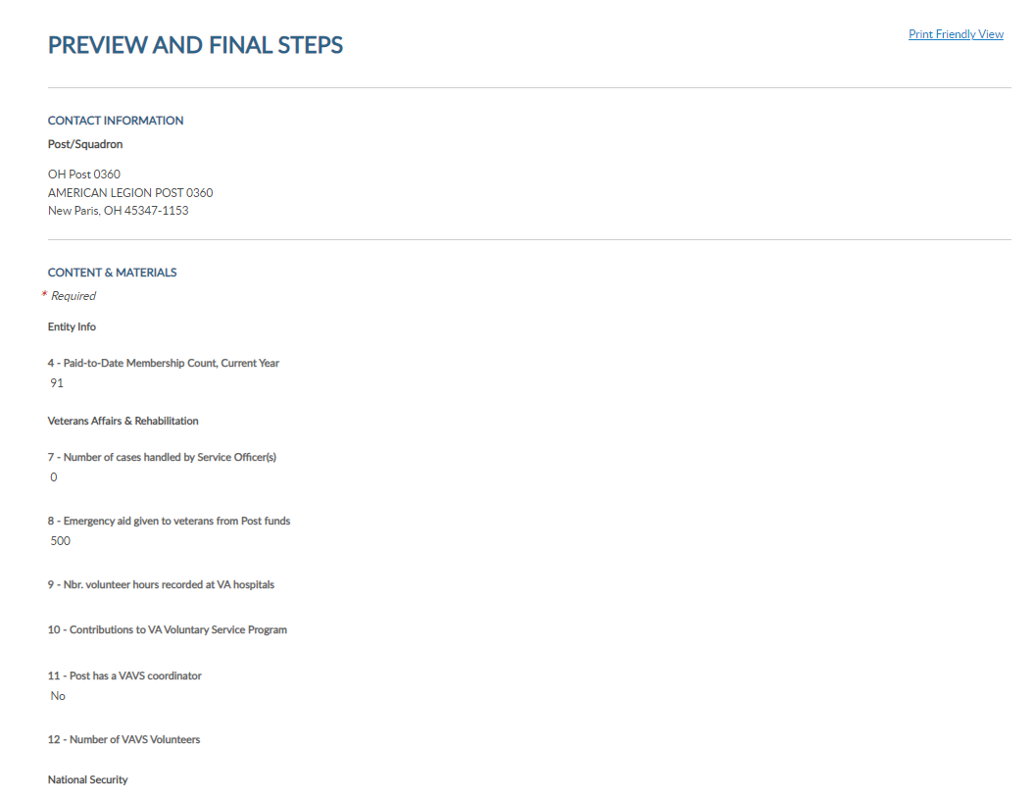
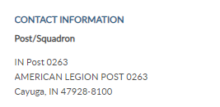
Consolidated Reports
Notes:
Select Print Friendly View to advance to Print. <1> <2> This allows you to print the report as a PDF document.

Slide 11
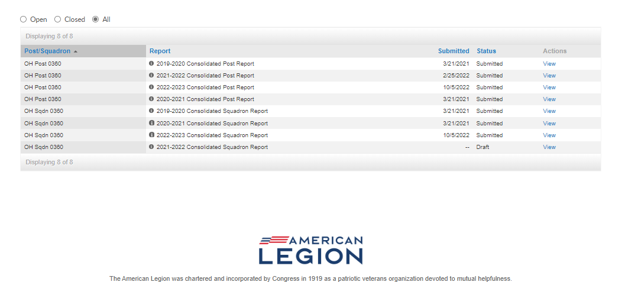
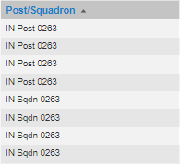
Consolidated Reports
Notes:
The All section includes current and previous years reports beginning 2019-20.

Slide 12
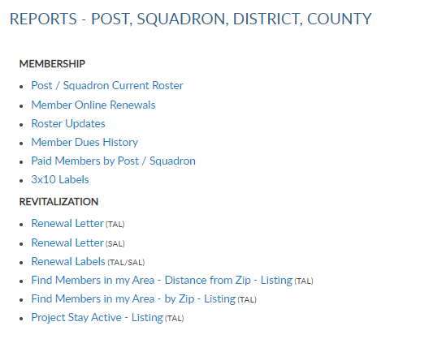
Notes:
Membership listings, roster updates, members renewed online, HQ member listings, mailing labels and a renewal letter are available through Reports/Labels.
Reports include post and squadron membership assigned to your group.

Slide 13
Current Roster
Displays members who are currently assigned to your post. Includes expired and deceased.
Notes:
The next report is the post and squadron current roster. This listing only includes current members of your group. Members who have transferred out, are not included in this listing. To view members who have transferred out that have paid to your post, generate a Paid Members By Post/Squadron report.
Select post/squadron Current Roster blue hyperlink to begin. <1> All reports are created using data filters. Filtering menus allow flexibility to the data included in the roster. The first field selected is Group. Using the pulldown menu, select the group and proceed to last paid year. A group can be post, squadron, county, and district First select the group.

Slide 14
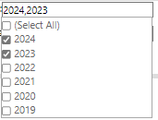
Current Roster
Displays members who are currently assigned to your post. Includes expired and deceased.
Notes:
Select Last Paid Year. Current membership year will vary depending on the time of the calendar year. Membership is active from Jan 1 to Dec. 31. The new membership campaign begins July 1 therefore, July 1 through Dec 31, two last paid years run concurrently.

Slide 15
Current Roster
Displays members who are currently assigned to your post. Includes expired and deceased.
Notes:
Status includes active and deceased. Deceased members will remain on the roster and can be filtered out by selecting active only.

Slide 16
Current Roster
Displays members who are currently assigned to your post. Includes expired and deceased.
Notes:
The next filter is mailing status. Mail status let’s you know if the mailing address on file is good or flagged as undeliverable. Members with undeliverable status do not receive The American Legion Magazine, renewal notices, or any mailings from National Headquarters. Contact those members, if possible, to collect a valid mailing address and update. Updating an address that marked as undeliverable will remove the flag. If a member states the address on file is good, contact National Customer Service to remove the flag.

Slide 17
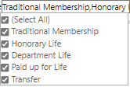
Current Roster
Displays members who are currently assigned to your post. Includes expired and deceased.
Notes:
Membership type includes traditional 1-year renewal, honorary life, department life, paid up for life and if the member is a current transfer.
After all data fields have been set, click View Report. <7>

Slide 18
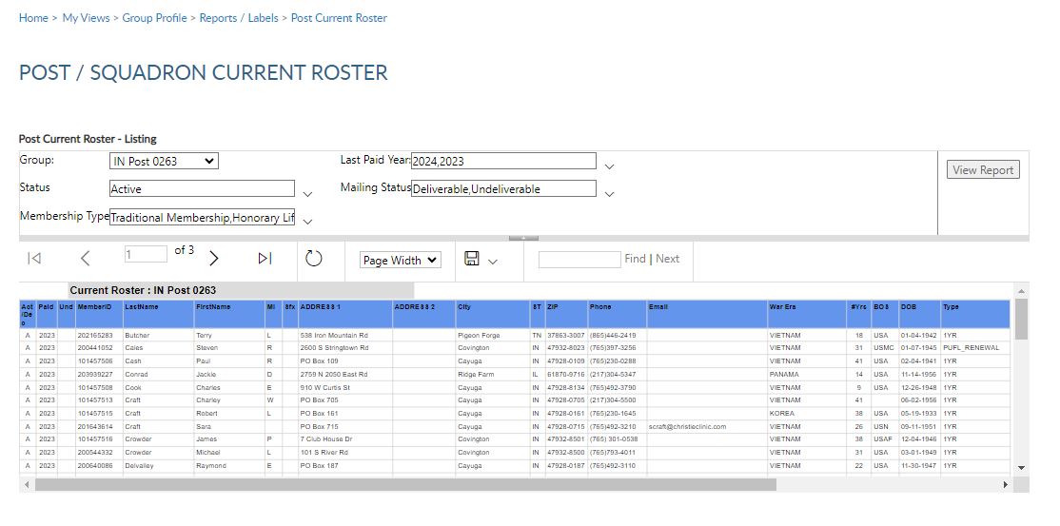
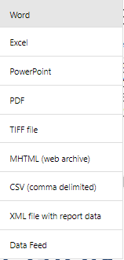
Current Roster
Displays members who are currently assigned to your post. Includes expired and deceased.
Notes:
The roster includes status, paid year, contact information, conflict, continuous years, branch of service, date of birth and membership type. Using the export Icon, export to an Excel document. <1>

Slide 19
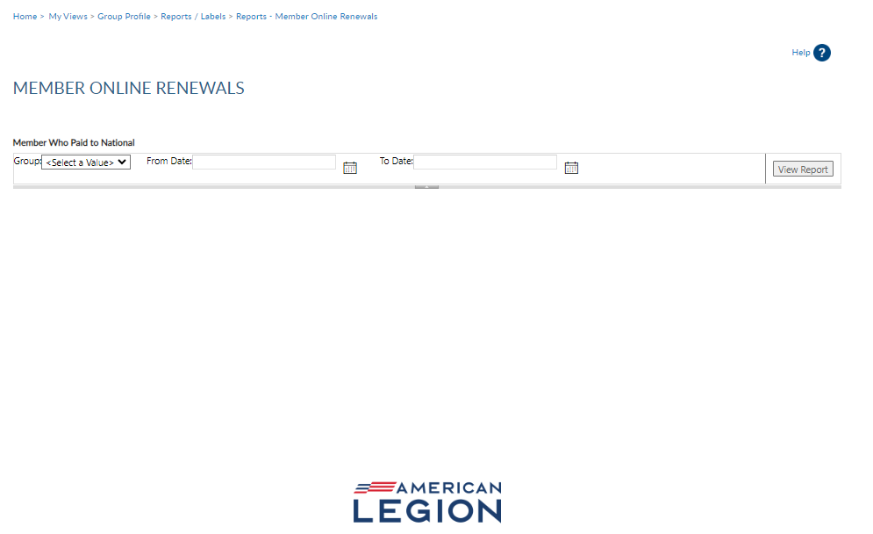
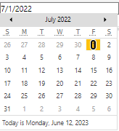
Member Online Renewal
Lists member paid online through national headquarters.
Notes:
Legion members that renew online can be identified using the Member Online Renewals Report.
Online renewal is available for Legion and Sons of the American Legion membership.
Click on the blue hyperlink to begin the members online renewal report. <1> Group selection is required. Date range selection is updated by clicking on the calendar icon. Use the left and right arrows to navigate by month and year. Click on the date in the calendar to set. <3> Click View Report to generate listing.

Slide 20
Member Online Renewal
Lists member paid online through national headquarters.
Total renewals this selection (1 Jul 2023 to 1 Jul 2023: 4 7/01/23 8:30PM
Notes:
This report provides the total count with names, member id#, date and renewal year. The amount paid displays the total amount of dues collected by the member, as reported on the annual post data report. When a member renews online, National collects post dues, and sends all others to the department to distribute.
If the post dues do not cover the minimum of national plus department, online renewal will not be available and result in an error message if the member attempts online renewal.
The export icon <1> is used to print and save reports. Reports are not saved within the report writer.

Slide 21
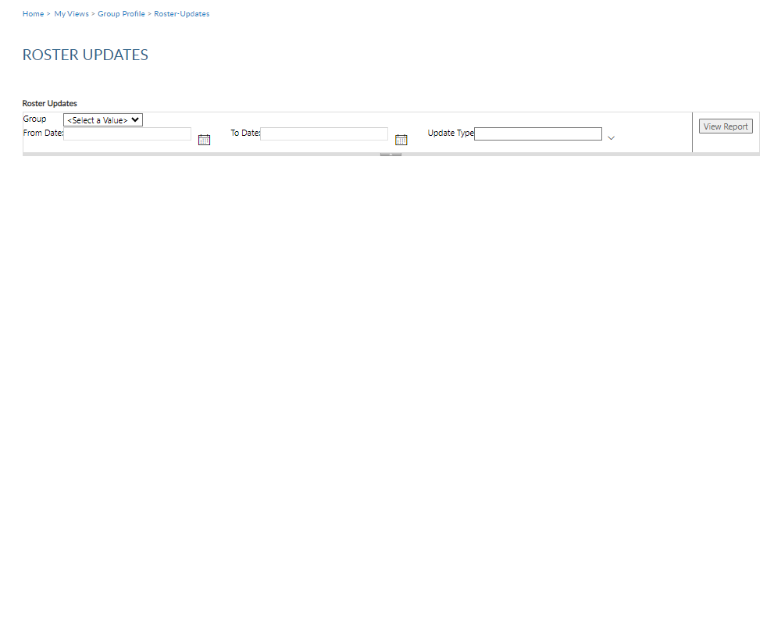
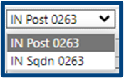
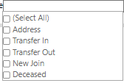
Roster Updates
Updates to member information for address, deceased status, transfer information and new members (new join).
Notes:
The next report is Roster Updates. This report helps identify members who have transferred in and out of your post or squadron, new joins and other updates made on the member record.
Select Roster Updates blue hyperlink to begin. <1>
Select your group <2>. Set date range using the calendar icons <3> will allow you set date parameters. Select update type <3>. After all filters are set <4> View Report to generate. <5>

Slide 22
Roster Updates
Updates to member information for address, deceased status, transfer information and new members (new join).
Notes:
To print or save, export to an Excel Document or PDF.

Slide 23
Member Dues History
Displays member payments from 2011 to current.
Notes:
View member dues history displays payment information from 2011 to present.

Slide 24
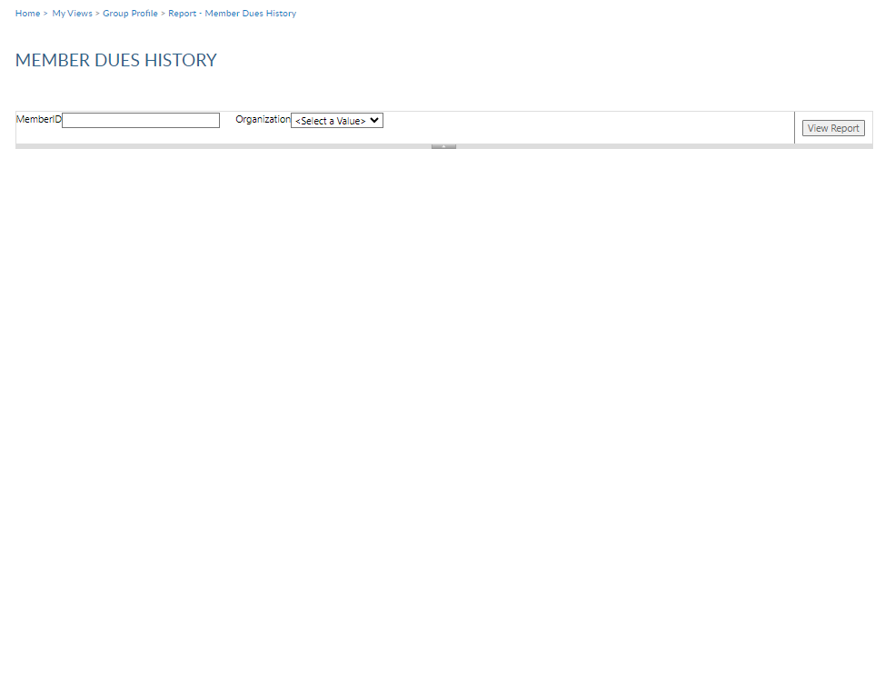
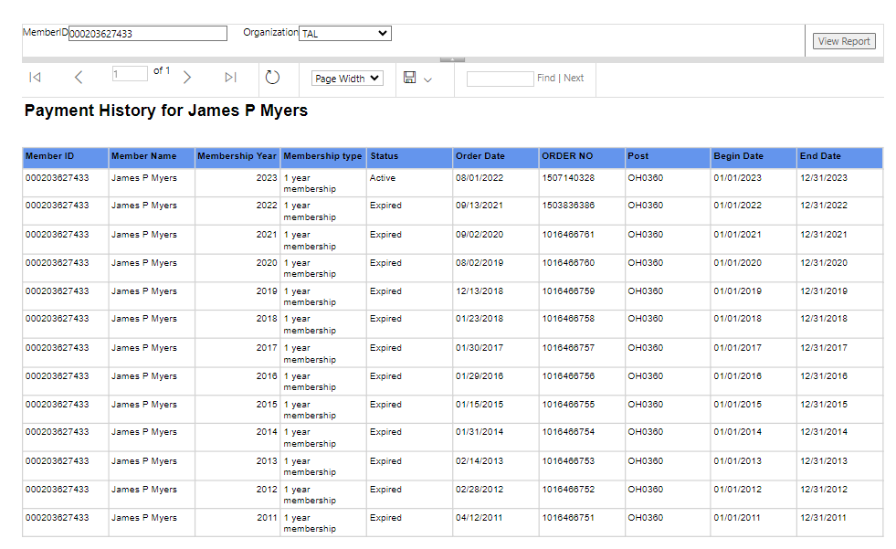
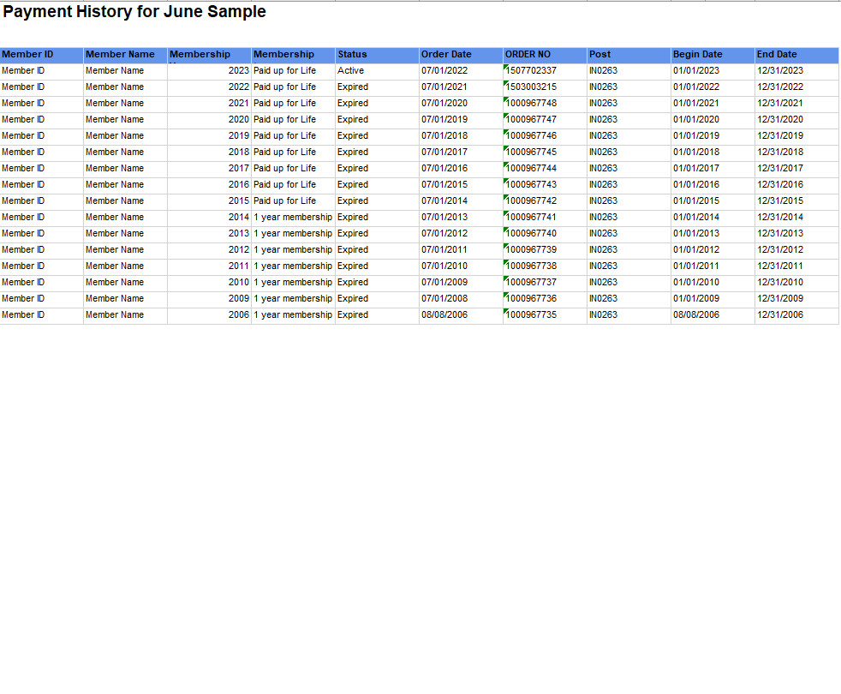
Member Dues History
Displays member payments from 2011 to current.
9-digit ID
9-digit ID
Notes:
<1>Enter the 9-digit membership number <2> , organization, <3> and click View Report <3>. Use the export icon to save or print. <4>

Slide 25
Paid Members
Paid members for the current membership year. Includes members who paid yet transferred out.
Notes:
The Paid Members report is the report corresponding with Department membership reports. It includes all members paid for the current year, even if they transferred out.

Slide 26
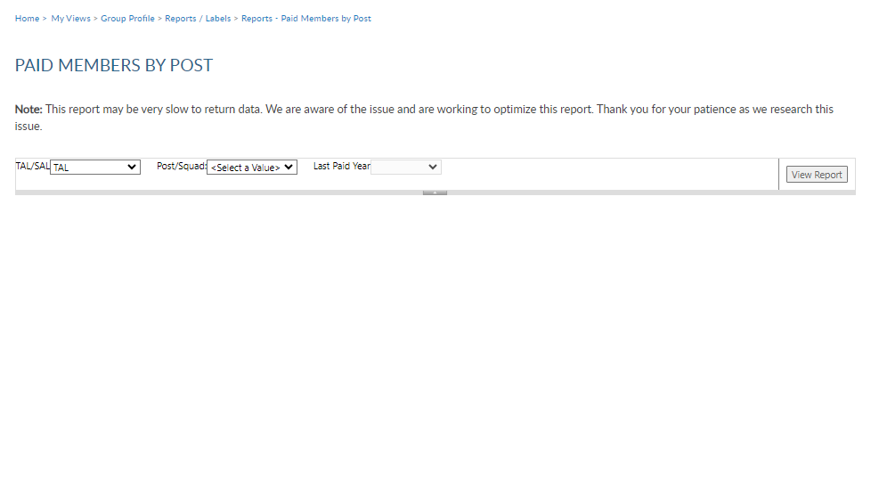
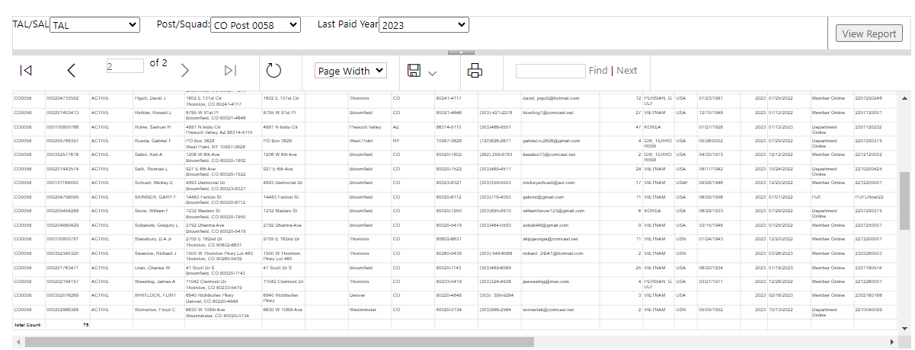
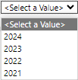
Notes:
Enter organization. <1> group <2> and last paid year <3> and View Report <4>.
<5> This report provides members paid to the post, even if transferred out. <6> The export icon allows you to view or print.

Slide 27
Mailing Labels
30 per sheet mailing labels for LGN and SAL members.
Notes:
3x10 labels produce a 30 per sheet label that fits Avery 5160 or any 30/sheet blank labels.
Click on the blue hyperlink to set filters and create labels. <1>

Slide 28
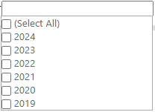
Notes:
Filtering options allows you to define the members included in labels. Deceased and members flagged as undeliverable will be suppressed from mailing labels.
>1> The first step is to select the group. <2> Select the last paid year or multiple years. <3> Designate if you want your labels sorted by last name or zip code.
<4> After parameters are set, View Report to continue.

Slide 29
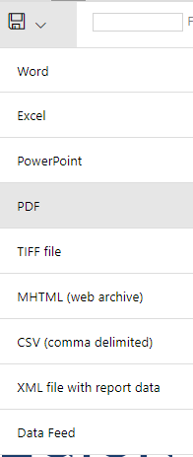
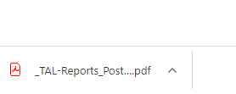
Name
Address
City, St, Zip
Name
Address
City,St, Zip
Name
Address
City,St, Zip
Notes:
The label display is not in 30/sheet format. Send the data to a PDF document selecting the export icon. <1> The export icon is used print and save all reports using the file types in the menu. PDF is the only selection that applies for labels. After you select PDF look for a tab to open the PDF generally located at the lower left of your window.

Slide 30
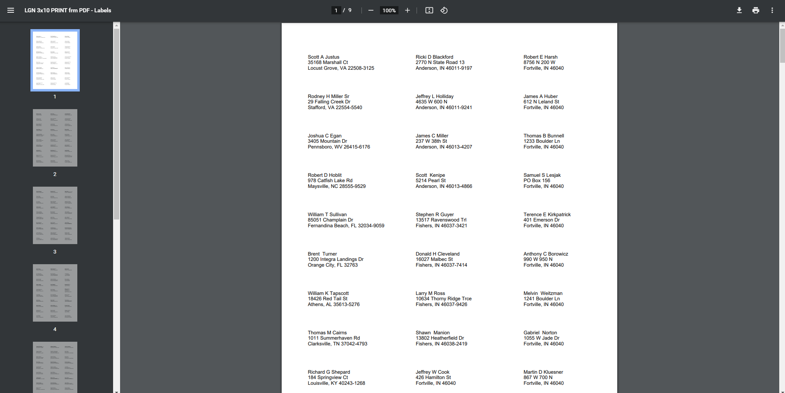
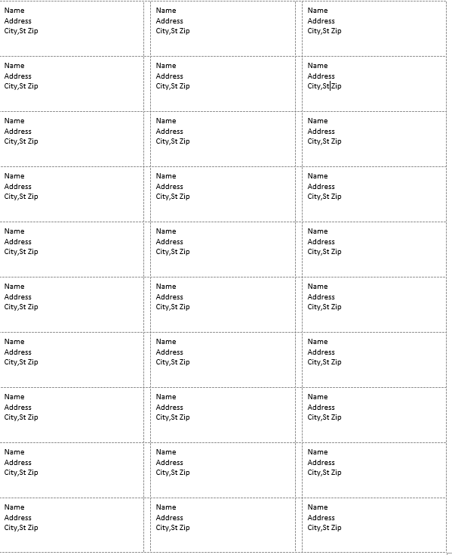
Notes:
The PDF opens to print labels. <1> Use the print icon to send to your printer.

Slide 31
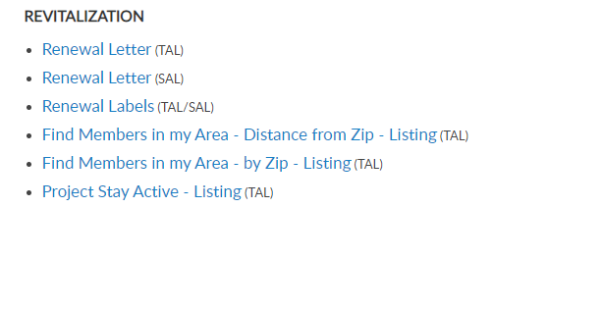
Renewal Letter & Labels
Pre-written custom letter inviting expired members to renew. Create labels for your letter using the same filter criteria.
Notes:
A renewal letter and labels are available to reach out to expired members.

Slide 32
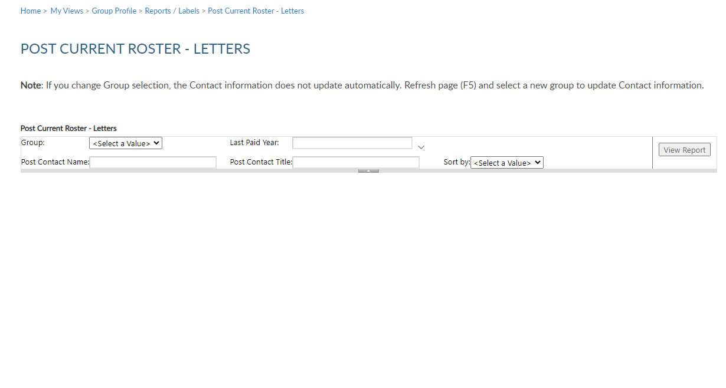
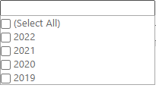
Notes:
Creating the letter begins with filters. Select the group first. This populates the contact name and title with commander information. <1> These fields can be modified by typing new text in the fields.
<2> Enter last paid year or multiple years, and sort option and click <3> View Report to generate.

Slide 33
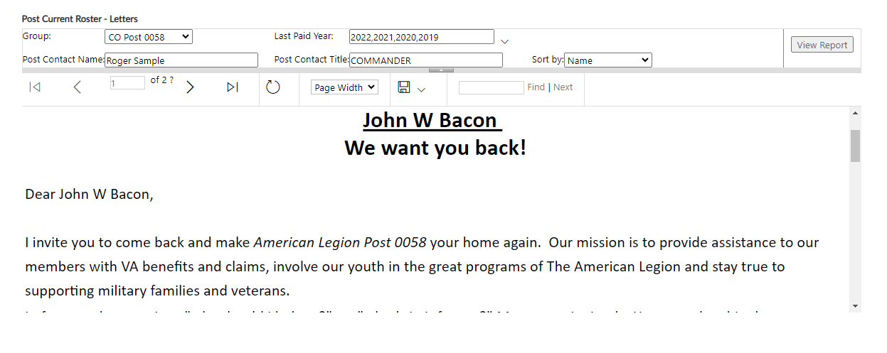
Notes:
The personalized letter generated to export to a PDF <1>.

Slide 34
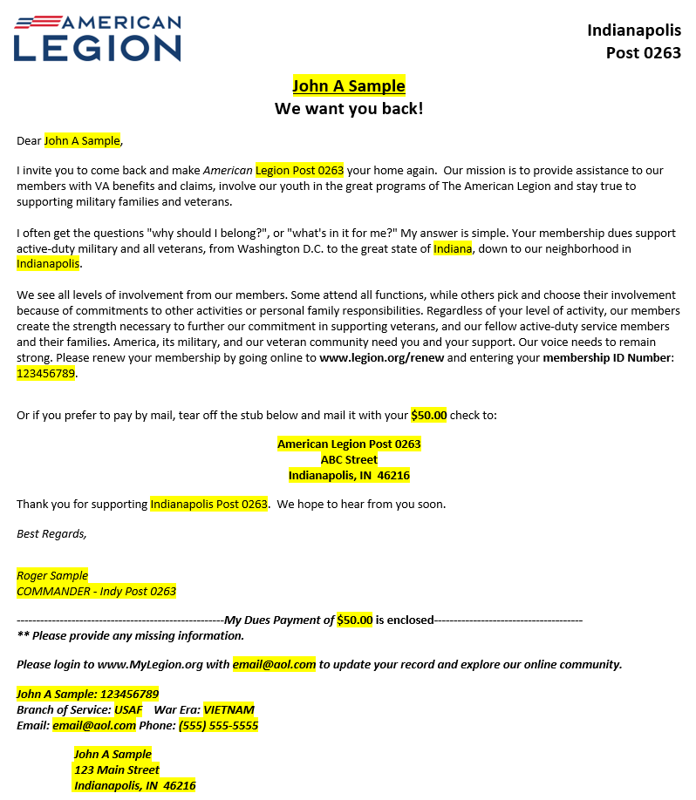
Notes:
The letter is personalized using member and post or squadron information including dues and dues remittance address.

Slide 35
Find Mbrs in my Area
Locate HQ post members by zip code. TAL only.
Radius + 1 zip search
Multi zip search
Notes:
To create a listing of HQs post members, begin in Reports and Labels – Find Members in My Area.
This report is only available to adjutants and commanders. Access to this report is not included with group administrator’s permission.
Find Members in my Area provides contact information for Legion members in your state headquarters post within a designated area defined by zip code. Click the Find Members in my Area blue hyperlink to set parameters and create report. <1>

Slide 36
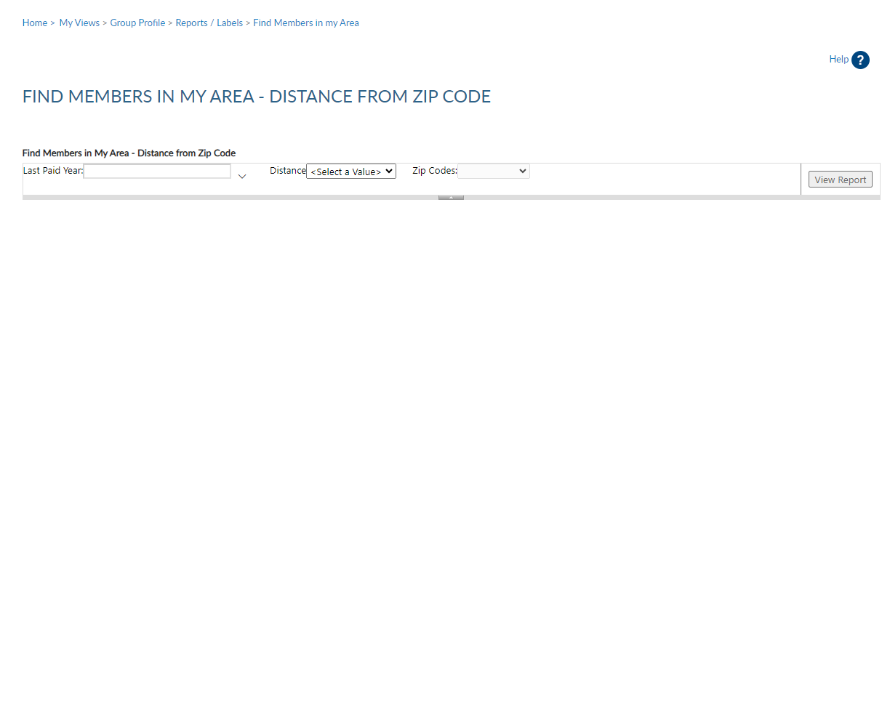
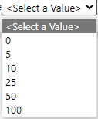
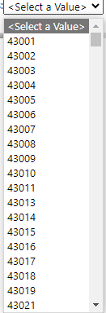
Notes:
When using this report, enter last paid year, distance, and zip code. Only one zip code can be selected and all zips are within the state. This report is not to be used to locate members in other departments. Click ”View Report” to generate.

Slide 37
Notes:
The report generates and is sorted alphabetically. It includes contact information on file at national headquarters. This listing can be exported to save or print using the export icon. <1>

Slide 38
Project Stay Active
Locate members who have moved into your area within the last 45 days.
Notes:
Locate members who have moved into your area within the last 46 days using the Project Stay Active listing.

Slide 39
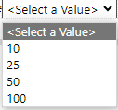
Notes:
Choose zip code and distance and View Report.

Slide 40
Notes:
The listing provides contact information to welcome the member to the community, introduce them to your post or squadron and invite them to transfer.

Slide 41
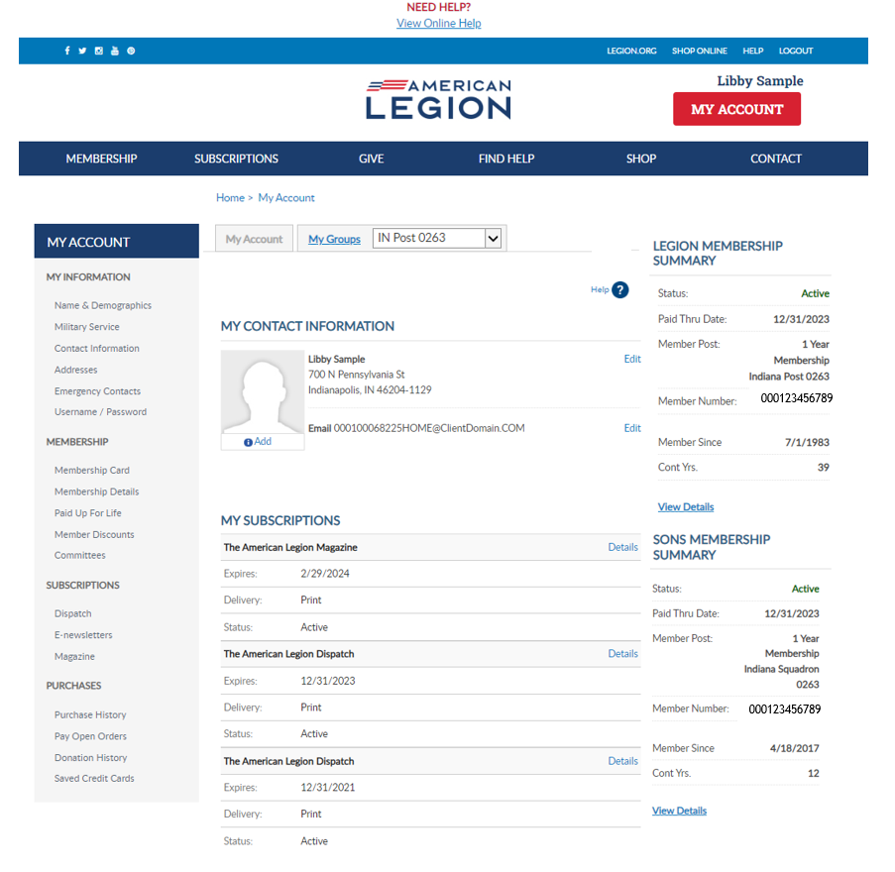
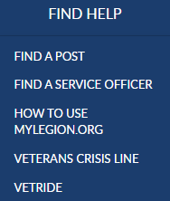
Online Help
Notes:
Online help is available from the top Menu “Find Help”.
Step by step instructions, videos and training presentations will assist with how to manage groups in MyLegion.

Slide 42
Online Help
Notes:
Step by step instructions, videos and training presentations will assist with how to manage groups in MyLegion.

Slide 43
MyLegion Support
Email:
mylegion@legion.org
Phone:
833.253.9995
Notes:
Your National support staff is available Monday through Friday, 8-4:30pm Eastern.

